Slide 1
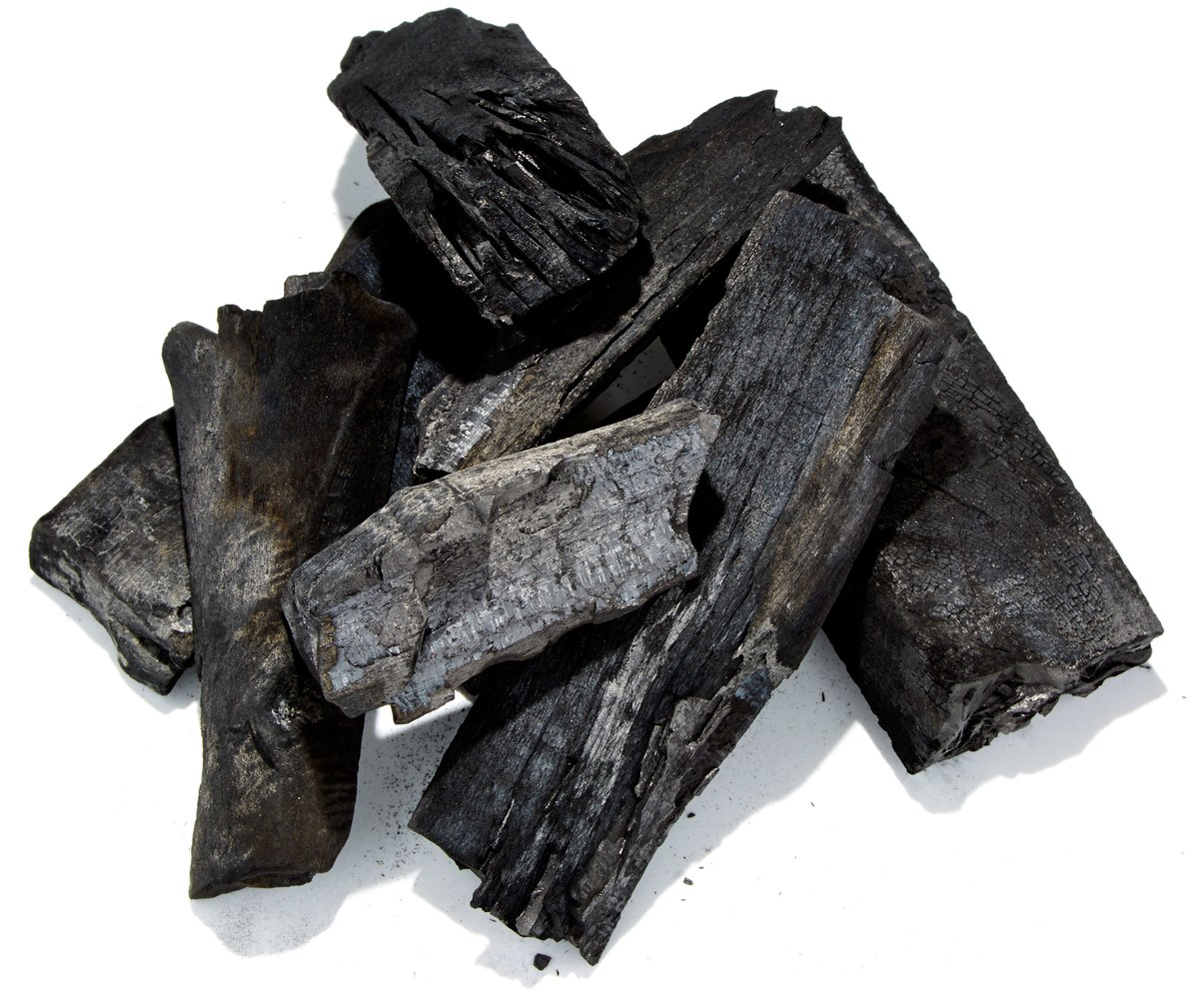
FOOFAH: Transforming Data by Example
A diamond is just a piece of charcoal with better structure
“Mark” Zhongjun Jin, Michael R. Anderson, Michael Cafarella, H. V. Jagadish
University of Michigan
Notes:
Good morning, everyone. Thanks for coming to my talk. I am Mark from University of Michigan and we have three other incredible researchers: Mike Anderson, Mike Cafarella, and H. V. Jagadish.

Slide 2
Unstructured Data is Unusable Until It is Transformed
Unstructured Contact Information
Bureau of I.A.
Regional Director | Numbers
Niles C. | Tel:(800)645-8397
 | Fax:(907)586-7252
Jean H. | Tel:(918)781-4600
 | Fax:(918)781-4604
Frank K. | Tel:(615)564-6500
 | Fax:(615)564-6701
…
Database
 | Tel | Fax
Niles C. | (800)645-8397 | (907)586-7252
Jean H. | (918)781-4600 | (918)781-4604
Frank K. | (615)564-6500 | (615)564-6701
…
Structured Contact Information
Notes:
As we all know that most data in the real-world are unstructured data. Performing data analysis, visualization or simply load them to the database is almost impossible, unless they are transformed into a better form, e.g. a relational form

Slide 3
Traditional Data Transformation is Expensive
Unstructured Contact Information
Bureau of I.A.
Regional Director | Numbers
Niles C. | Tel:(800)645-8397
 | Fax:(907)586-7252
Jean H. | Tel:(918)781-4600
 | Fax:(918)781-4604
Frank K. | Tel:(615)564-6500
 | Fax:(615)564-6701
…
Structured Contact Information
Bureau of I.A.
Regional Director | Numbers
Niles C. | Tel:(800)645-8397
 | Fax:(907)586-7252
Jean H. | Tel:(918)781-4600
 | Fax:(918)781-4604
Frank K. | Tel:(615)564-6500
 | Fax:(615)564-6701
…
?
 | Tel | Fax
Niles C. | (800)645-8397 | (907)586-7252
Jean H. | (918)781-4600 | (918)781-4604
Frank K. | (615)564-6500 | (615)564-6701
…
Use Excels
Write programs
Notes:
I guess most people will bet their luck on editing tools like Excel to perform such a transformation. But the amount of the effort quickly becomes intolerable as long as the data is larger than just a few records. Normally, programmers are hired to write programs to automate such transformation process. Yet, these code are hard to maintain and programmers today are very expensive.

Slide 4
Traditional Data Transformation is Expensive
Unstructured Contact Information
Bureau of I.A.
Regional Director | Numbers
Niles C. | Tel:(800)645-8397
 | Fax:(907)586-7252
Jean H. | Tel:(918)781-4600
 | Fax:(918)781-4604
Frank K. | Tel:(615)564-6500
 | Fax:(615)564-6701
…
Structured Contact Information
Bureau of I.A.
Regional Director | Numbers
Niles C. | Tel:(800)645-8397
 | Fax:(907)586-7252
Jean H. | Tel:(918)781-4600
 | Fax:(918)781-4604
Frank K. | Tel:(615)564-6500
 | Fax:(615)564-6701
…
?
 | Tel | Fax
Niles C. | (800)645-8397 | (907)586-7252
Jean H. | (918)781-4600 | (918)781-4604
Frank K. | (615)564-6500 | (615)564-6701
…
Use Excels
Write programs
???
Notes:
Then is there any cheaper solution to data transformation?

Slide 5
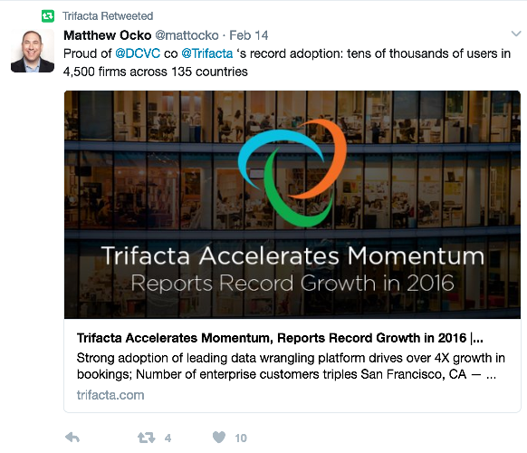
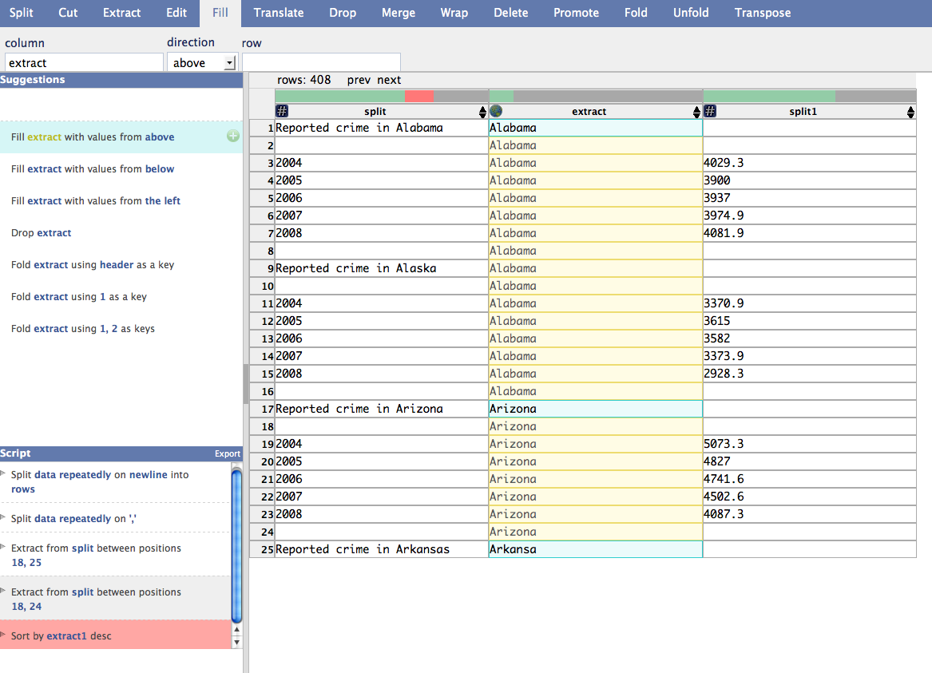
Data Wrangler
“Wrangler: Interactive Visual Specification of Data Transformation Scripts”, Sean Kandel, Andreas Paepcke, Joseph Hellerstein and Jeffrey Heer, CHI 2011.
Notes:
Thanks to Prof Joe Hellerstein and his collbaorators from berkeley and stanford, we got Data Wrangler, provides an easy-to-use visualized data transformation framework. Data Wrangler project is very successful and was turned into a San-Francisco based start-up Trifacta. Their product are used by tens of thousands of real users across the world, and was recently integrated as a data preparation service in google cloud platform. For simplicity, we will just focus on Data Wrangler prototype today.

Slide 6
Programming-By-Demonstration(PBD) Model
System learns the program by user demonstrating the actions required to complete the task
Step 1: User Partially Demonstrates an Operation
No programming skills required!
Possible to improve?
Step 2: System Suggests Some Operations
Step 3: User Picks an Operation
Notes:
Data Wrangler follows a programming-by-demonstration paradigm to synthesize the data transformation programs: 1. User first select a region in the data table where she wants to perform some operations. It could a column, a row, or a cell. 2. The data wrangler system then suggests a set of data transformation operations applicable for this selected region. 3. The user picks one operation, and the system applies this selected operation on the current data and displays the transformed view on the data table. And the user goes through rounds of this process until she finally transform the data into the desired format. This seems to be easier than writing programs. But this might still be a lots of hassle for average users for the following reasons

Slide 7
Usability Issues with Programming-By-Demonstration Data Transformation
Repetitive and tedious
User effort is proportional to program length
Requires good knowledge about data transformation

Slide 8
Our Proposal
Data Transformation through Programming-By-Example (PBE)
User provides input-output examples rather than selecting the correct operations
Previous data transformation PBE work by Gulwani et. al.
FlashFill [Gulwani 2011], FlashRelate [Barowy et. al. 2015], ProgFromEx [Harris, Gulwani 2011]
Notes:
As opposed to programming by demonstration paradigm, we believe a programming by example paradigm is superior in reducing the user effort. Because all the system needs to know is user’s description about the input and output data. Therefore, in our project, we decided to follow pbe approach to synthesize a data transformation program. Note that we are not the first people who tried programming by example for data transformation. Dr. Gulwani from MSR has done many important work on this area. But we observe that most of their work are very restricted to specific types of data transformation. We will show this in our experiments.

Slide 9
Outline
Introduction
Problem Definition
Our Solution
Program Synthesis as a Search Problem
A New Heuristic: Table Edit Distance + batching
Experiments
Conclusion
Notes:
Let’s first clarify what is the problem that we are solving in our project

Slide 10
Expected PBE Interaction Model
Foofah
Input-output Example
Synthesized Program
Raw Data
Notes:
Here is our proposed user interaction model.

Slide 11
User Input
Input-output Example:$ℰ$= (e_{i}, e_{o})
$ℰ =$ Sampled raw data e_{i} + Transformed view of the sample e_{i}
Machine Learning
Data
Visualization
e_{i}
e_{o}
Data Integration
Notes:
The user input to our proposed synthesis technique is the input-output example. The input example is a sample of the raw data and the output example is the transformed view of this sample.

Slide 12
Sample Input-output Example
Bureau of I.A.
Regional Director | Numbers
Niles C. | Tel: (800)645-8397
 | Fax: (907)586-7252
Jean H. | Tel: (918)781-4600
 | Fax: (918)781-4604
Bureau of I.A.
Regional Director | Numbers
Niles C. | Tel: (800)645-8397
 | Fax: (907)586-7252
Jean H. | Tel: (918)781-4600
 | Fax: (918)781-4604
Frank K. | Tel: (615)564-6500
 | Fax: (615)564-6701
…
Sampled raw data
 | Tel | Fax
Niles C. | (800)645-8397 | (907)586-7252
Jean H. | (918)781-4600 | (918)781-4604
Raw data
Transformed view of the sample
Notes:
Bob’s case

Slide 13
System Output
Potter’s Wheel program:
A sequence of parameterized Potter’s Wheel operators [Raman, Hellerstein 2001]
Potter’s Wheel program
Operators 𝓕:
Drop, Move, Copy, Merge, Split, Fold, Unfold, Fill, Divide, Delete, Extract, Transpose
𝓕₁[p₁, p₂,…](x)
𝓕₂[p₁, p₂,…](x)
…maybe more
Raw Data
“Evolved” Data
More “Evolved” Data
Notes:
The system output is a loop-free program parameterized by PW operators. A loop-free program is a straight-line program parametrized by the set of operators/components used. The second operator takes in the output of the first operator and so and and so forth. No outer-loops or conditions exist in the program.

Slide 14
Problem to Solve
Synthesize a program 𝒫 that takes e_{i} as the input and outputs e_{o}
?
?
?
Machine Learning
Data Transformation Program
𝒫
Data
Visualization
e_{i}
e_{o}
Data Integration
Notes:
Finally, the problem to solve in our project is to find such a loop-free program that takes in user-provided sampled raw data and outputs the transformed view of the sample.

Slide 15
Raw Data
A grid of values, i.e., spreadsheets
“Somewhat” structured: must have some regular structure or is automatically generated.
System Log
E-receipt
Health Records
AND MORE …
Notes:
The raw data we want to transform in our project is a grid of values, an example could be spreadsheets. The data has to follow some regular structures which means these data are usually automatically generated. Some examples could be system log data (txt data that are in csv format, where splitter is space or \t are taken in as tabular form). A counter example could be twitter posts, news articles.

Slide 16
Desired Transformations
Supported: Layout transformations and/or syntactic transformations
Not Supported: Semantic transformations
E.g., May 17 2017 → 05 17 2017
05-16-2017
05-17-2017
05-18-2017
…
05/16/2017
05/17/2017
05/18/2017
…
Example of a layout transformation
Example of a syntactic transformation
Notes:
At this moment, we do not consider semantic transformations. A simple example of semantic transformation is transforming ”May” into “05”. Such transformation requires outside information which our system currently does not incorporate

Slide 17
Outline
Introduction
Problem Definition
Our Solution
Program Synthesis as a Search Problem
A New Heuristic: Table Edit Distance + batching
Experiments
Conclusion

Slide 18
Program Synthesis as a Search Problem
?
Input Example e_{i}
Output Example e_{o}
Notes:
From our view, the process of synthesized program is similar to a search problem.

Slide 19
Program Synthesis as a Search Problem
Unfold
?
Split
Input Example e_{i}
Output Example e_{o}
Delete
Fold
Fill

Slide 20
Program Synthesis as a Search Problem
Unfold
Unfold
Fold
Split
?
Fill
Input Example e_{i}
Output Example e_{o}
Delete
Fold
Split
Fill

Slide 21
Program Synthesis as a Search Problem
Unfold
Unfold
Fold
Split
Fold
Fill
Unfold
Input Example e_{i}
Output Example e_{o}
Delete
Fold
Split
Split
Fill
Search Space: All transformation programs
States: Different views of the data
Edges: Parameterized operators
Notes:
When we picture our problem in this way: this is the input example provided by the user as an initial state, this is the output example as a goal state, the sequence of operations is like a path that connects input and output example.

Slide 22
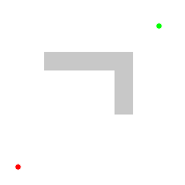
A* Search
A* search algorithm keeps exploring the most promising node - smallest f(n)
f(n) = g(n) + h(n)
Estimated Part: estimated distance to the goal state
Observed Part: traveled distance for the current state
Intermediate state ‘n’
Notes:
A* search algorithm is an approach that is commonly used to solve the search problem. A* keeps exploring the most promising intermediate state, which is the state with the smallest f score, until it reaches the goal state. F score is the sum of traveled distance and heuristic, which is the estimated distance to the goal state.

Slide 23
Applying A* Search Algorithm in Our Problem
Cost function: # of Potter’s Wheel operators
Split
Fill
Input Example e_{i}
Output Example e_{o}
g(n): “# of Potter’s Wheel operators”
h(n): ?

Slide 24
Requirements for Heuristic
Easy to compute
Effective
Prioritizes correct states, punishes incorrect states
Heuristic scale is not too large
If heuristic score is too large, A* search could be misled by imperfect heuristic
f(n) = g(n) + h(n)
h(n) ≫ g(n)
f(n) ≈ h(n)
Notes:
We define table edit distance as the heuristic function. But in practice, it is not a perfect heuristic because it is much larger than potter’s wheel distance because it is proportional to the data size. And when this is the case. A* algorithm is simply a greedy algorithm and can be mislead by the heuristic severely. To alleviate this issue, we create a fix based on another observation.

Slide 25
Possible Heuristics and Why They Are Bad
Operator-level heuristic
Estimate # of Potter’s Wheel operations to use
Requirements for heuristic
Easy to compute ❌
Effective❓
Close to g(n) scale ✔
Estimating # of Potter’s Wheel operators is hard. Details are in our paper.
Notes:
With these requirements in our mind let’s brainstorm some of the possible heuristic design. Intuitively, we might want to have an operator-level heuristic which estimates the actual number of potter’s wheel operators to use. But this is hard unless we already know what operator to use. Therefore, it is not easy to compute and is unclear whether it is effective.

Slide 26
Possible Heuristics and Why They Are Bad
Operator-level
Estimate # of Potter’s Wheel operations to use
Column-level heuristic
# of different columns
Requirements for heuristic
Easy to compute ✔
Effective ❌
Close to g(n) scale ❓
Operators like Fold, Unfold, Delete, Transform, etc., move or remove cells across multiple columns
Notes:
Since estimating the # of operators is hard, let’s try some simple heuristic, like a column-level heuristic. For example, we can estimate # of different columns in two tables. Although, this is easy to compute, it is essential very inaccurate because many operators transform across multiple columns.

Slide 27
Possible Heuristics and Why They Are Bad
Operator-level heuristic
Estimate # of Potter’s Wheel operations to use
Column-level heuristic
# of different columns
Cell-level heuristic
Requirements for heuristic
Easy to compute ✔
Effective ❓
Close to g(n) scale ❓
Intuition:
A correct operation makes table more similar to its desired state
The similar a table is to its desired state, the fewer cells need to be changed
Notes:
In our project, we decided to use a cell-level heuristic based on our heuristic that #1 a correct transformation makes data more similar to its desired state, #2 the similar a table is to its desired state.

Slide 28
Outline
Introduction
Problem Definition
Our Solution
Program Synthesis as a Search Problem
A New Heuristic: Table Edit Distance + batching
Experiments
Conclusion
Notes:
Add the naïve heuristic section

Slide 29
Observation about Data Transformation Ops
Most data transformation operations can be seen as many cell-level transformation operations:
Add
Remove
Move
Transform
Notes:
We made an observation that almost all of the Potter’s Wheel operations can be seen as many cell-level transformation operation. Split for example can be seen as cell transform operations

Slide 30
Cell-level operators
Alice | Math | A+
Mike Anderson | University of Michigan | PhD Student
 | Math
Alice | A+
Mike Anderson | University of Michigan
Add a cell
Remove a cell
Move a cell
Transform a cell
Alice | Math | A+
Mike Anderson | University of Michigan | PhD Student
Alice | A+ | Math
Mike Anderson | University of Michigan | PhD
Notes:
We made an observation that almost all of the Potter’s Wheel operations can be seen as many cell-level transformation operation. Split for example can be seen as cell transform operations

Slide 31
Example: Split operation
Split on ‘:’
Tel: (800)645-8397
Fax: (907)586-7252
Tel | (800)645-8397
Fax | (907)586-7252
Potter’s Wheel Operator
Cell-level Operator
Transform (0,0) to (0,1)
Transform (0,0) to (0,0)
Tel: (800)645-8397
Tel
(800)645-8397
Fax: (907)586-7252
Fax
(907)586-7252
Transform (1,0) to (1,0)
Transform (1,0) to (1,1)
Notes:
We made an observation that almost all of the Potter’s Wheel operations can be seen as many cell-level transformation operation. Split for example can be seen as cell transform operations

Slide 32
Cell-level heuristic: Table Edit Distance
Table Edit Distance Definition:
$$Distance\left(T_{1}, T_{2}\right)=\min_{\left(p_{1},…, p_{k}\right)∈P\left(T_{1}, T_{2}\right)}{\sum_{i=0}^{k}{cost\left(p_{i}\right)}}$$
P(T₁, T₂): Set of all “paths” transforming T₁ to T₂ using cell-level operators
p₁,…, p_{k}: cell-level operators, including
Add, Remove, Move & Transform
Notes:
Now let’s be clear about the cell-level distance metric we are discussing here. To transform a table into another form, there might be multiple ways using cell-level operations. The distance metric is the cheapest way among all possible approches. The cell-level operations are add, remove, move and. transform.

Slide 33
Current Cell-level Heuristic Is
Easy to compute ✔
Effective: Prioritizing correct states, punishing incorrect states ✔
Close to g(n) scale ❓
Notes:
Graph edit distance is known to be np-complete. Therefore we choose to approximate our table edit distance using greedy method. We simply choose the cheapest operation to formulate each cell in the output table sequentially and remove the remaining cells from the input table. The distance is the sum of cost of the all operations.

Slide 34
Observation about data transformation operators
Data transformation operators (and their cell-level operators) transform geometrically-adjacent cells
Tel: (800)645-8397
Tel
(800)645-8397
Fax: (907)586-7252
Fax
(907)586-7252
Tel: (918)781-4600
Tel
(918)781-4600
Fax: (918)781-4604
Fax
(918)781-4604
1 Split = 8 Transforms on 2 groups of Vertically adjacent cells
Notes:
We observe that potter’s wheel operators transform geometrically adjacent cells. And the corresponding cell-level transformations are also transforming geometrically-adjacent cells.

Slide 35
Our Solution: Table Edit Distance Batch
Group geometrically-adjacent cell-level operations by their goemetric patterns
Requirements for heuristic
Easy to compute ✔
Effective ✔
Close to g(n) scale ✔
Tel: (800)645-8397
Tel
Tel: (800)645-8397
(800)645-8397
Fax: (907)586-7252
Fax
Fax: (907)586-7252
(907)586-7252
Tel: (918)781-4600
Tel
Tel: (918)781-4600
(918)781-4600
Fax: (918)781-4604
Fax
Fax: (918)781-4604
(918)781-4604
Table Edit Distance + Batch has exponential complexity. We use greedy algorithm. Detailed algorithm is in our paper
batched Transform 1
batch Transform 2

Slide 36
Outline
Introduction
Problem Definition
Our Solution
Program Synthesis as a Search Problem
A New Heuristic: Table Edit Distance + batching
Experiments
Conclusions

Slide 37
Claims
Our proposed PBE technique:
Can handle most data transformation tasks
Requires a little user effort
Is generally efficient (small system runtime)
Notes:
In our experiment we want to demonstrate that our proposed pbe data transformation technique can solve many real world data transformation tasks, and it reduces the user effort.

Slide 38
Test Settings
Prototype
Foofah
Benchmark Workload
50 test scenarios collected from related work: ProgFromEx [Harris, Gulwani 2011], Wrangler [Kandel et. al., 2011], Potter’s Wheel [Raman, Hellerstein 2001], ProactiveWrangler [Guo et. al. 2011]
Baselines
FlashRelate, ProgFromEx, Wrangler
Test Environment
a 16-core (2.53GHz) Intel Xeon E5630 machine with 120 GB RAM
Notes:
We implemented our proposed technique in a prototype called foofah. We collected benchmarking test scenarios from several related work. Our selection criteria is the transformation has to generate a relational tabular data. In total 50 test scenarios are selected. The testing environment is as follows.

Slide 39
Test Approach: lazy approach [Harris, Gulwani 2011]
Input Example
+ Output Example
raw data
one record
synthesized program
raw data
Foofah
perfectly transformed
End
one record incorrectly transformed
Notes:
We first want to evaluate the performance of foofah in all test scenarios. We follow a lazy approach that is used by other related PBE work. We pick one record and create the transformed view of this record and send them as an input-output example to our system. If the synthesized program is not good enough, we use this input example and another record from the raw data that the synthesized program fails to handle to formulate a new input example. We then create the transformed view of this new example and send it together with the new input example as input to our system and test again. We interact with foofah in this manner until we finally get a high quality program.

Slide 40
Foofah Handles Most Transformation Tasks
Conclusion:
Foofah can handle most of benchmark workload
Ideally, Wrangler should handle as many tasks as our system
Notes:
roughly tie with other system on layout transformations and better than other in synatactic transformation

Slide 41
Foofah Requires Few Inputs
Conclusion:
Foofah mostly requires a small input-output example (input example contains no more than 2 records) in our test workload

Slide 42
Foofah is Efficient
Average Runtime: 1.4 Seconds
Conclusion:
System runtime for each synthesis is short for most benchmark workload
Notes:
The results show that Foofah is able to find perfect programs for 90% of the test scenarios using 1 or 2 records. In the rest 5 test scenarios. 4 of them are due of the lack of appropriate operators.
We also measured the responsiveness. The graph shows the average and worst response time in each round among all test scenarios. 74% within 5 seconds and 86% within 10 seconds. Average is 1.4 seconds

Slide 43
Foofah Saves More User Effort than Wrangler
Test Settings:
8 selected tasks covering both complex and simple tasks
10 grad student participants
600 seconds limit for each task
Conclusion
Foofah on average requires about 60% less user effort than Wrangler and never loses
Notes:
The result shows that foofah on average reduce 60% user effort. And more in those that require complex operators.
Due to the differences in the interaction model. Wrangler needs more mouse clicks and foofah needs more key strokes.

Slide 44
Conclusion and Future Work
The proposed PBE data transformation technique:
Consumes less user effort than state-of-the-art PBD data wrangling system Data Wrangler
Solves more data transformation tasks than existing PBE data transformation systems
Next:
Build interface allowing the user to incorporate new operators
Add tolerance for inaccurate user-provided examples

Slide 45
Thanks to prior works and, of course, you!
Kandel, Sean, et al. “Wrangler: Interactive visual specification of data transformation scripts.” CHI, 2011.
V. Raman and J. M. Hellerstein. “Potter’s Wheel: An interactive data cleaning system”. VLDB, 2001.
Gulwani, Sumit. "Automating string processing in spreadsheets using input-output examples." ACM SIGPLAN Notices. Vol. 46. No. 1. ACM, 2011.
Harris, William R., and Sumit Gulwani. "Spreadsheet table transformations from examples." ACM SIGPLAN Notices. Vol. 46. No. 6. ACM, 2011.
Barowy, Daniel W., et al. "FlashRelate: extracting relational data from semi-structured spreadsheets using examples." ACM SIGPLAN Notices. Vol. 50. No. 6. ACM, 2015.
Guo, Philip J., et al. "Proactive wrangling: mixed-initiative end-user programming of data transformation scripts." Proceedings of the 24th annual ACM symposium on User interface software and technology. ACM, 2011.

Slide 46
Demonstrating Example: Unfold operation
Unfold columns2, column3 on column3
Niles C. | Tel | (800)645-8397
Niles C. | Fax | (907)586-7252
 | Tel | Fax
Niles C. | (800)645-8397 | (907)586-7252
Potter’s Wheel Operator
Cell-level Operator
Move (0,2) to (1,1)
Niles C.
Tel
(800)645-8397
Tel
Fax
Delete (0,0)
Niles C.
Fax
(907)586-7252
Niles C.
(800)645-8397
(907)586-7252
Move (1,1) to (0,2)
Notes:
A more complex example is unfold, which can be seen as moving two cells and deleting a cell.

Slide 47
Table Edit Distance Batch
Batch “geometric patterns”
Vertical-to-vertical, vertical-to-horizontal, horizontal-to-horizontal, horizontal-to-vertical
one-to-horizontal, one-to-vertical
Horizontal-to-null, vertical-to-null

Slide 48
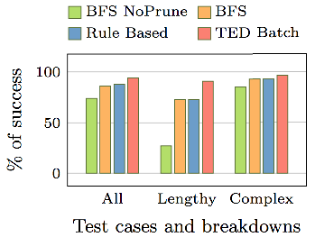
Experiments on Competing Algorithms

Slide 49
Pruning Rules

Slide 50
Experiments on Adding New Operators

