Slide 1
Beaver: Towards a Declarative Schema Mapping June 10th @ HILDA 2018
“Mark” Zhongjun Jin
Christopher Baik
Michael Cafarella
H. V. Jagadish
@zhongjun_jin
Notes:
Hi,

Slide 2
What is Schema Mapping?
Schema mapping
transform data from data sources in different schemas to the desired schema.
Notes:
Schema mappings are specifications relating multiple relations with different schemas

Slide 3
What is Schema Mapping?
Schema mapping in a relational database setting
a query joining multiple schemas to form the desired schema

Slide 4
Challenges in Schema Mapping
Hand-writing schema mapping SQL queries can be painful
Lack of Expertise
Complex Database
Notes:
Hand-writing schema mappings can be very painful for two reasons: 1) analysts lack of proficiency in sql and 2) the databases themselves are too complex to understand

Slide 5
Analysts lack of expertise in SQL
12 (out of 35) analysts
reported having the IT team write SQL queries (instead of themselves).
(Kandel, 2012)
Some (of the other 23) data analysts could only write simple SQL queries without joins.
(Kandel, 2012)
Notes:
A recent interview study about enterprise data analysts performed by Prof. Joe Hellerstein and his colleagues discovered a quite a few of senior data analysts still have other professionals write sql queries for them due to lack of sql proficiency. Some of the other analysts who write sql by themselves only write simple ones.

Slide 6
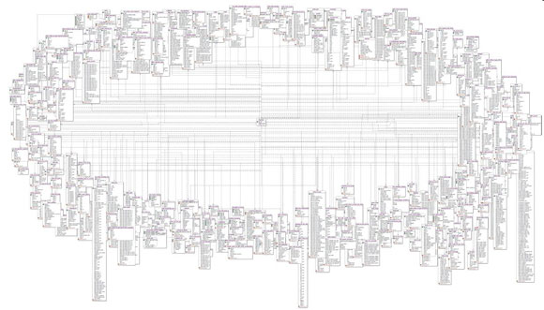
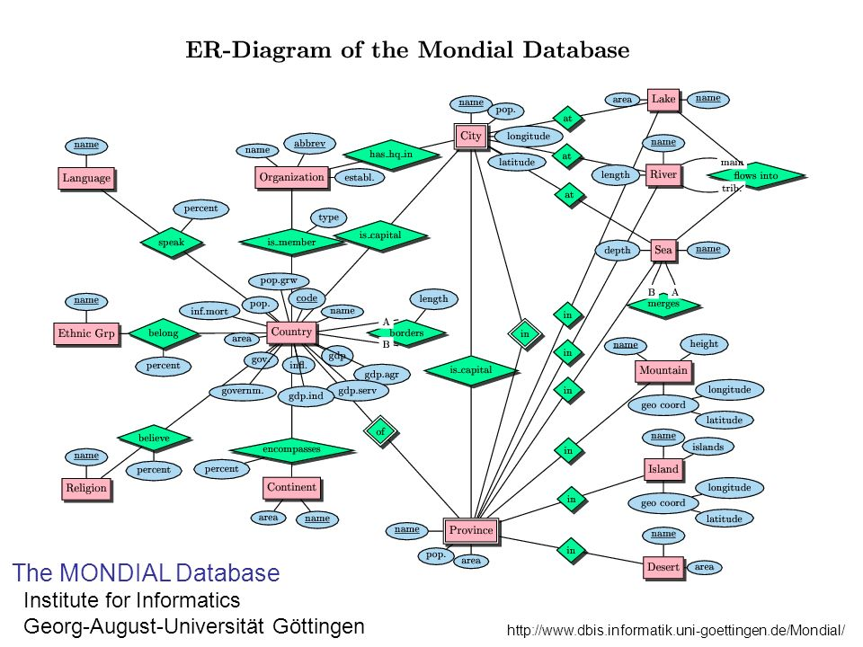
Real-world DBs Are Complex & Huge
In class:
Even analysts comfortable writing complex SQL require IT staff to help find the appropriate data and understand its structure and schema
Protein Data Bank
(>400 tables, >3000 columns)
Real world:
(Kandel, 2012)
And even worse …
Notes:
Unlike the toy examples we learned from the database class, the databases in the real world are in fact much more complex. And even SQL experts often need to be taught to understand the database schemas.

Slide 7
Two Schema Mapping Synthesis Approaches
Match-driven Schema Mapping
Sample-driven Schema Mapping
Notes:
Therefore, instead of hand writing schema mappings. Ideas have been proposed to synthesize schema mappings automatically. Such researches can be categorized into two groups: match-driven schema mapping, sample-driven schema mapping.

Slide 8
Match-driven Schema Mapping
Iterative Interaction Model
User selects a relation.
System suggests the potential relations to join.
E.g., IBM Clio (Popa, 2002), BizTalk Mapper¹, Altova MapForce², etc.
http://www.microsoft.com/biztalk/en/us/
http://www.altova.com/mapforce.html
Notes:
Examples of match driven schema mapping include IBM clio, biztalk mapping, altova mapforce etc. A typical interaction model in the match-driven schema mapping is that the system suggests possible joins based on user selection of attributes and relations.

Slide 9
Interaction Example
The MONDIAL Database (May, 1999)
“List all the lakes with their area and the states they belong”
WARNING
User needs to understand the database schemas well !
User
Tables to join with “Lake”:
Country,
geo_lake
…
All tables
after a few interactions…
Select table “Lake”
Select table “geo_lake”
System
Notes:
We here use mondial database as an example. …In the end, the system emits a sql query that reproduce the join process the user selects. You may think this approach is pretty straight forward and schema mapping is nothing difficult.

Slide 10
Sample-driven Schema Mapping
Iterative Interaction Model
User provides new samples from the desired schema.
System prunes unsatisfying schema mappings
E.g., MWeaver (Qian, 2012), Filter (Shen, 2014), etc.
Notes:
The 2nd approach for schema mapping is sample driven schema mapping. Two examples adopting this approach are Mweaver and Filter. A typical interaction is that the user provides the sample data records in the desired schema and the system infers the schema mappings matching the examples.

Slide 11
Interaction Example
The MONDIAL Database (May, 1999)
“List all the lakes with their area and the states they belong”
WARNING
The user might not have precise knowledge about the database content?
Excellent!
User does not need to understand database schema
User
Column 1 | Column 2 | Column3
Lake Tahoe | California | 497 km²
Column 1 | Column 2 | Column3
Lake Tahoe | California | 497 km²
Great Salt Lake | Utah | 4400 km²
Lake Mendota | Wisconsin | 15 km²
Column 1 | Column 2 | Column3
Lake Tahoe | California | 497 km²
Great Salt Lake | Utah | 4400 km²
Narrow down to one satisfying SQL query? Yes!
Narrow down to one satisfying SQL query? No.
System
Notes:
You thought we finally got a good solution. But providing correct and complete samples is not as easy as it seems.

Slide 12
User is unfamiliar with database content
Hmm… Which state is “Lake Tahoe” in?
What’s its area?
User
Column 1 | Column 2 | Column3
Lake Tahoe
Column 1 | Column 2 | Column3
Lake Tahoe
Column 1 | Column 2 | Column3
Lake Tahoe
Column 1 | Column 2 | Column3
System
Notes:
It might be difficult for most people to memorize where the lake is or the area of a lake.

Slide 13
Outline
Motivation
Proposal: Declarative Schema Mapping
Problem Formulation & Solution
Early Experiments
Future Work

Slide 14
Our Proposal
Allow the users to contribute their knowledge as best as they can
It’s either California or Nevada
Hmm… Which state is “Lake Tahoe” in?
It’s >100 km² and
<1000 km²
What’s its area?
User
Column 1 | Column 2 | Column3
Lake Tahoe
Column 1 | Column 2 | Column3
Column 1 | Column 2 | Column3
Lake Tahoe | California OR Nevada
Column 1 | Column 2 | Column3
Lake Tahoe | California OR Nevada | >100 km² and <1000 km²
System
Notes:
Bi

Slide 15
Our Proposal
The requirement for exact examples is relaxed, the user can add
Multiple possible values connected by “OR”
Value range
Column 1 | Column 2 | Column3
Lake Tahoe | California OR Nevada | >100 km² and <1000 km²

Slide 16
Our Proposal
The requirement for exact examples is relaxed, the user can add
Multiple possible values connected by “OR”
Value range
Incomplete examples
Column 1 | Column 2 | Column3
Lake Tahoe | California OR Nevada | >100 km² and <1000 km²
Great Salt Lake | Utah

Slide 17
Our Proposal
The requirement for exact examples is relaxed, the user can add
Multiple possible values connected by “OR”
Value range
Incomplete examples
Or even “metadata” constraints that describe single columns.
E.g., data type, value range, and more in the future
Column 1 | Column 2 | Column3
Lake Tahoe | California OR Nevada | >100 km² and <1000 km²
Great Salt Lake | Utah
Sample Constraints
Metadata Constraints
Column 1 | Column 2 | Column3
 |  | {numeric} AND >0

Slide 18
Outline
Motivation
Proposal: Declarative Schema Mapping
Problem Formulation & Solution
Early Experiments
Future Work

Slide 19
Problem Formulation
Given
A database D
User Input
Sample Constraints C_{sample}
Metadata Constraints C_{meta}
Problem
Synthesize a SQL query (SPJ query) matching C_{sample} and C_{meta} for D

Slide 20
Algorithm (Step 1)
Identify related relations & columns
Column 1 | Column 2 | Column3
“Lake Tahoe” | “California” OR “Nevada” | > 100 and < 1000
Name
Area
Area
Depth
Population
Lake
Geo_lake
Sea
Country

Slide 21
Algorithm (Step 2)
Discover all possible ways to join related relations
Column 1
Name
Area
Province
Column 2
Complete Join Path #1
Lake
Geo_Lake
Column 3
Lake.Name = Geo_Lake.Lake
Name
Province
Population
Lake.Name = Geo_Lake.Lake
Complete Join Path #2
Lake
Geo_Lake
Country
Lake.Country = Gountry.Name
Complete Join Path #3
…
Complete Join Path #n

Slide 22
Algorithm (Step 3)
Prune complete join paths mismatching any sample constraint
Column 1
Column 1 | Column 2 | Column3
“Lake Tahoe” | “California” OR “Nevada” | > 100 and < 1000
Column 2
✓
Column 3
Name
Province
Population
Lake.Name = Geo_Lake.Lake
Complete Join Path #2
Lake
Geo_Lake
Country
X
Lake.Country = Gountry.Name

Slide 23
Outline
Motivation
Proposal: Declarative Schema Mapping
Problem Formulation & Solution
Early Experiments
Future Work

Slide 24
Experiments
Today’s Claim
Synthesis time is the same for declarative schema mapping queries and sample-based schema mapping queries
Claim in the future
Declarative schema mapping queries are easier to provide than sample-based schema mapping queries
Dataset: MONDIAL
Prototype system: Beaver
MySQL 5.5
Running on 16-core Intel Xeon server with 128 GB RAM
Notes:
Mention that in the future we will show declarative schema mapping queries are easier to provide for the user

Slide 25
How to Generate Test Workload?
Randomly Synthesized SQL Queries
Database
Query Results
Sample
Traditional Sample-based Queries
Sample-based System
Synthesized SQL Queries
Synthesize
Declarative Schema Mapping Queries
Beaver
System
Synthesized SQL Queries
Notes:
The question is how can we find the test queries?

Slide 26
Declarative Schema Mapping Workload
Synthesize declarative queries (from sample-based queries)
Disjunctive queries
Incomplete queries
Metadata queries

Slide 27
Declarative Schema Mapping Workload
Synthesize declarative queries (from sample-based queries)
Disjunctive queries
Incomplete queries
Metadata queries
Column 1 | Column 2 | Column3
Lake Tahoe | California | 497 km²
Sample-based query
Column 1 | Column 2 | Column3
Lake Tahoe | California OR Nevada | 497 km²
Declarative query

Slide 28
Declarative Schema Mapping Workload
Synthesize declarative queries (from sample-based queries)
Disjunctive queries
Incomplete queries
Metadata queries
Column 1 | Column 2 | Column3
Lake Tahoe | California | 497 km²
Sample-based query
Column 1 | Column 2 | Column3
Lake Tahoe | California
Declarative query

Slide 29
Declarative Schema Mapping Workload
Synthesize declarative queries (from sample-based queries)
Disjunctive queries
Incomplete queries
Metadata queries
Column 1 | Column 2 | Column3
Lake Tahoe | California | 497 km²
Sample-based query
Column 1 | Column 2 | Column3
Lake Tahoe | California
Sample
constraints
Declarative query
Column 1 | Column 2 | Column3
 |  | {numeric} AND >0
Metadata constraints

Slide 30
Results
Sample-based queries usually finish within 1 second
Declarative queries cost 0-5 seconds more than sample-based queries
Conclusion
Synthesis time is almost the same for declarative schema mapping queries and sample-based schema mapping queries.
Notes:
Add takeaway points

Slide 31
Outline
Motivation
Proposal: Declarative Schema Mapping
Problem Formulation & Solution
Early Experiments
Future Work

Slide 32
Future Work
Users might have many other insights about the desired schema
Relations/attributes used
Join conditions
Selection predicate
The 1st column and the 2nd column can be obtained by a join.
The 1st column should be from relation “Employee”
Only select values >= 100,000 in the 3rd column
User
And…
User constraints might not be flawless.

Slide 33
The End. Questions?

Slide 34
Reference
Kandel, S., Paepcke, A., Hellerstein, J. M., & Heer, J. (2012). Enterprise data analysis and visualization: An interview study. IEEE Transactions on Visualization and Computer Graphics, 18(12), 2917-2926.
Popa, L., Velegrakis, Y., Miller, R. J., Hernández, M. A., & Fagin, R. (2002). Translating web data. In VLDB'02: Proceedings of the 28th International Conference on Very Large Databases (pp. 598-609).
Microsoft biztalk server. http://www.microsoft.com/biztalk/en/us/.
Altova mapforce. http://www.altova.com/mapforce.html.
May, W. (1999). Information Extraction and Integration with Florid: The Mondial Case Study.
Qian, L., Cafarella, M. J., & Jagadish, H. V. (2012, May). Sample-driven schema mapping. In Proceedings of the 2012 ACM SIGMOD International Conference on Management of Data (pp. 73-84). ACM.
Shen, Y., Chakrabarti, K., Chaudhuri, S., Ding, B., & Novik, L. (2014, June). Discovering queries based on example tuples. In Proceedings of the 2014 ACM SIGMOD international conference on Management of data (pp. 493-504). ACM.

